Slide 1
Diabetes predict using decision tree machine learning model
DIABETES PREDICTION MODEL

Slide 2
Diabetes
Diabetes is a chronic condition that affects how your body processes glucose (sugar). There are two main types:
Type 1 Diabetes: This is an autoimmune condition where the pancreas produces little to no insulin. It usually develops in children or young adults but can occur at any age.
Type 2 Diabetes: This is more common and typically develops in adults. In this case, the body either becomes resistant to insulin or doesn't produce enough. It's often linked to lifestyle factors like diet and physical inactivity.

Slide 3
Diabetes Factor Affecting
Diabetes matters in many feature-
There are some following feature, based on we build a model to predict whether the person has diabetes or not –
1 – Age,
2 – Gender,
3 – Hyper-tension,
4 – Heart-disease,
5 – Smoking-history,
6 – Bmi,
7 - HbA1c_level,
8 - Blood_glucose_level

Slide 4
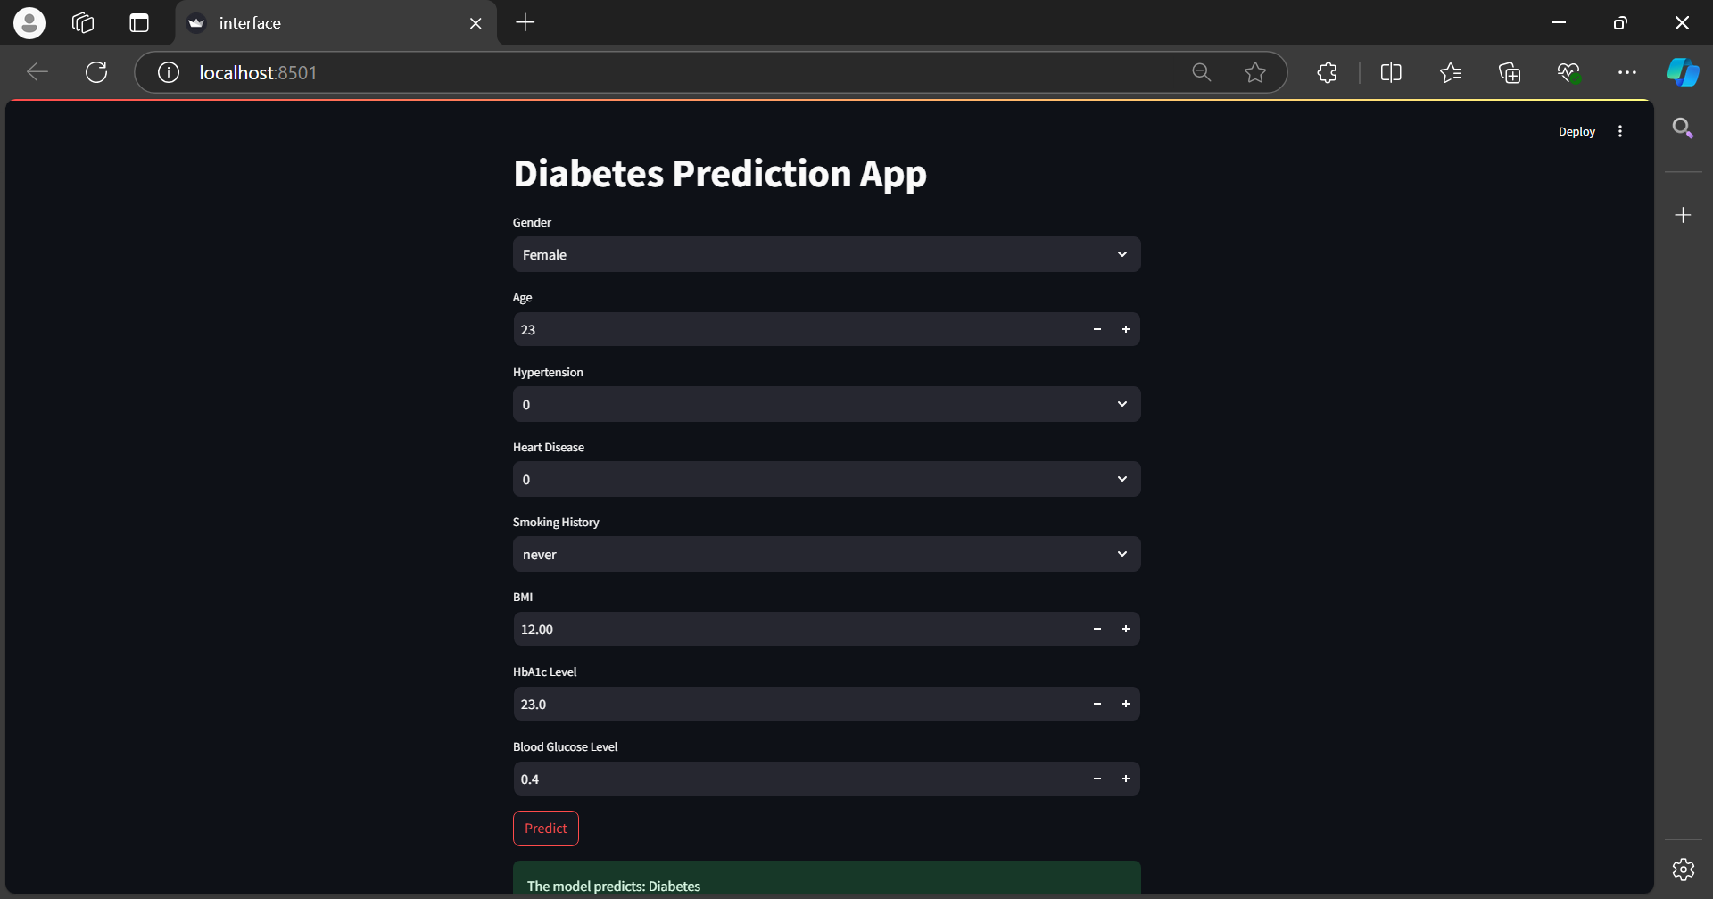
Model interface

Slide 5
THANK YOU

